Slide 1
Estimate The Presence Of Impurities In Iron Ore Using Machine Learning
PRESENTED BY:
TEAM NO: CSE-012
18UK1A0544 -Polu Ravichandra
18UK1A0563 - Ambati Akshaya
18UK1A0504 - Bairishetty Sahithi
18UK1A0526 - Jadala Karthik

Slide 2
OUTLINE
INTRODUCTION
OBJECTIVE
DATA
MACHINE LEARNING APPROACHES
VISUALIZATION OF GRAPHS
SOFTWARE REQUIREMENTS
CONCLUSION

Slide 3
INTRODUCTION
Iron ores are rocks and minerals from which metallic iron can be economically extracted. Iron is usually found in the form of Magnetite, Hematite, Goethite, Limonite, or Siderite. Usually, Magnetite Iron ore concentrate contains an impurity of 3–7% of silica. Estimation of silica involves a lot of chemical analysis which is time-consuming and involves high operational cost. In order to cut down the operational cost and also to help engineers by predicting at a faster rate, we make use of Machine Learning (ML). So the main goal of this project is to build a Machine Learning model to predict the impurities present in an Iron ore.

Slide 4
OBJECTIVE
You’ll be able to understand the problem to classify if it is a regression or a classification kind of problem.
You will be able to know how to pre-process/clean the data using different data preprocessing techniques.
You will able to analyze or get insights into data through visualization.
Applying different algorithms according to the dataset and based on visualization.
You will be able to know how to build a web application using the Flask framework.

Slide 5
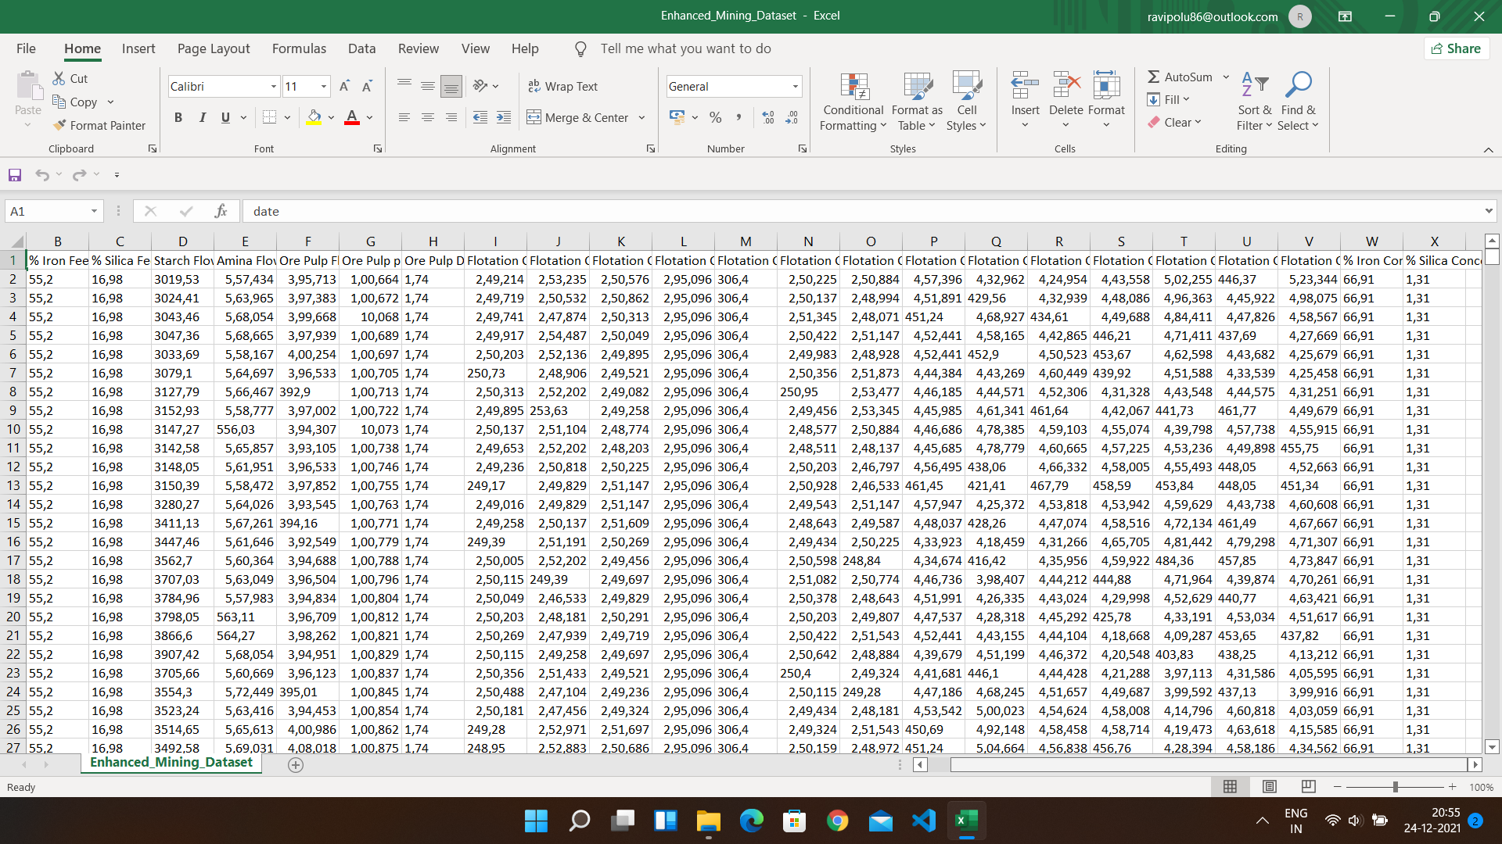
DATA
Estimate The Presence Of Impurities In Iron ore dataset consists of:
346476 rows with 7 columns
%Iron Feed, silica Feed, Starch Flow, Amina Flow, Ore pulp Flow, Ore pulp Flow, Ore pulp Density, Flotation Column 01 Air Flow, Flotation Column 02 Air Flow, Flotation Column 03 Air Flow, Flotation Column 04 Air Flow, Flotation Column 05 Air Flow, Flotation Column 06 Air Flow, Flotation Column 07 Air Flow, Flotation Column 01 Air Flow, Flotation Column 02 Level, Flotation Column 03 Level, Flotation Column 04 Level, Flotation Column 05 Level, Flotation Column 06 Level, Flotation Column 07 Level, Iron Concentrate, Silica Concentrate
Data source: Internet

Slide 6
DATA VISUALISATION
Data visualization is where a given dataset is presented in a graphical format. It helps the detection of patterns, trends and correlations that might go undetected in text-based data. Understanding your data and the relationship present within it is just as important as any algorithm used to train your machine learning model. Machine learning models will perform poorly on data that wasn’t visualized and understood properly.
To visualize the dataset we need libraries called Matplotlib and Seaborn. The Matplotlib library is a Python 2D plotting library that allows you to generate plots, scatter plots, histograms, bar charts etc.

Slide 7
MODEL BUILDING
There are several Machine learning algorithms to be used depending on the data you are going to process such as images, sound, text, and numerical values. The algorithms that you can choose according to the objective that you might have it may be Classification algorithms are Regression algorithms.
Example:
1.Linear Regression
2.Logistic Regression
3. Random Forest Regression / Classification.
4. Decision Tree Regression / Classification.
You will need to train the datasets to run smoothly and see an incremental improvement in the prediction rate.
On our Dataset , we have applied Random forest Regression / Classification.
to predict the Accuracy.

Slide 8
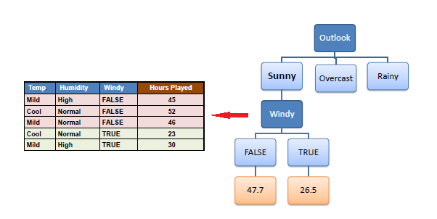
MACHINE LEARNING ALGORITHMS
Decision Tree Regression :
Decision Trees are a type of Supervised Machine Learning (that is you explain what the input is and what the corresponding output is in the training data) where the data is continuously split according to a certain parameter. An example of a decision tree can be explained using above binary tree.
Out of all the algorithms Decision Tree Regression got the highest accuracy .
So, We build a model with Decision Tree Regression.

Slide 9
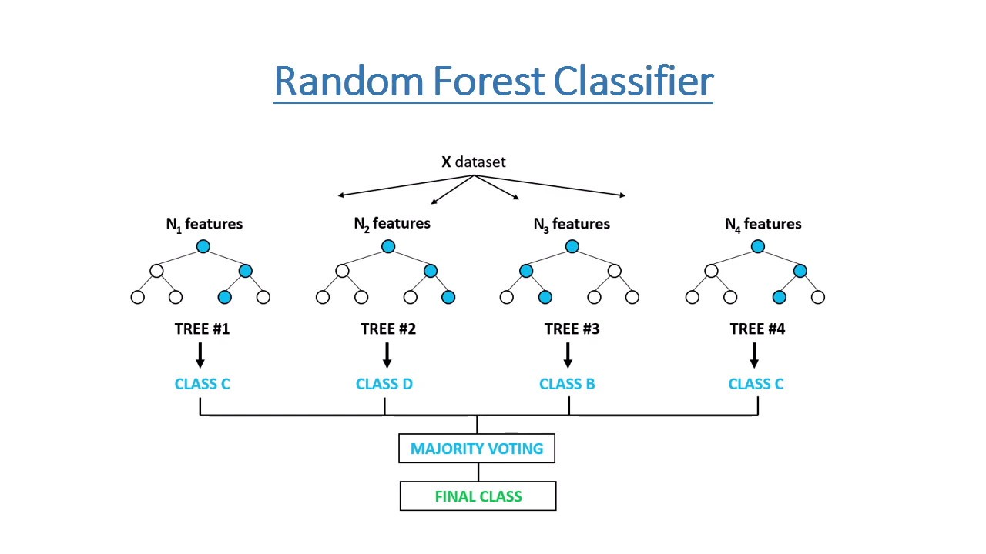
Random Forest :
A random forest is a machine learning technique that’s used to solve regression and classification problems. It utilizes ensemble learning, which is a technique that combines many classifiers to provide solutions to complex problems.
Working of Random Forest Algorithm
Step 1 − First, start with the selection of random samples from a given dataset.
Step 2 − Next, this algorithm will construct a decision tree for every sample. Then it will get the prediction result...
Step 3 − In this step, voting will be performed for every predicted result.
Step 4 − At last, select the most voted prediction result as the final prediction result.

Slide 10
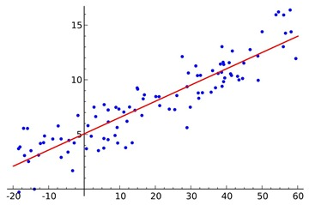
LOGISTIC REGRESSION:
Logistic regression is a supervised learning classification algorithm used to predict the probability of a target variable. The nature of target or dependent variable is dichotomous, which means there would be only two possible classes. ... Mathematically, a logistic regression model predicts P(Y=1) as a function of X.
Logistic Regression is used when the dependent variable (target) is categorical. For example,
To predict whether an email is a spam (1) or (0)
Whether the tumor is malignant (1) or not (0)

Slide 11
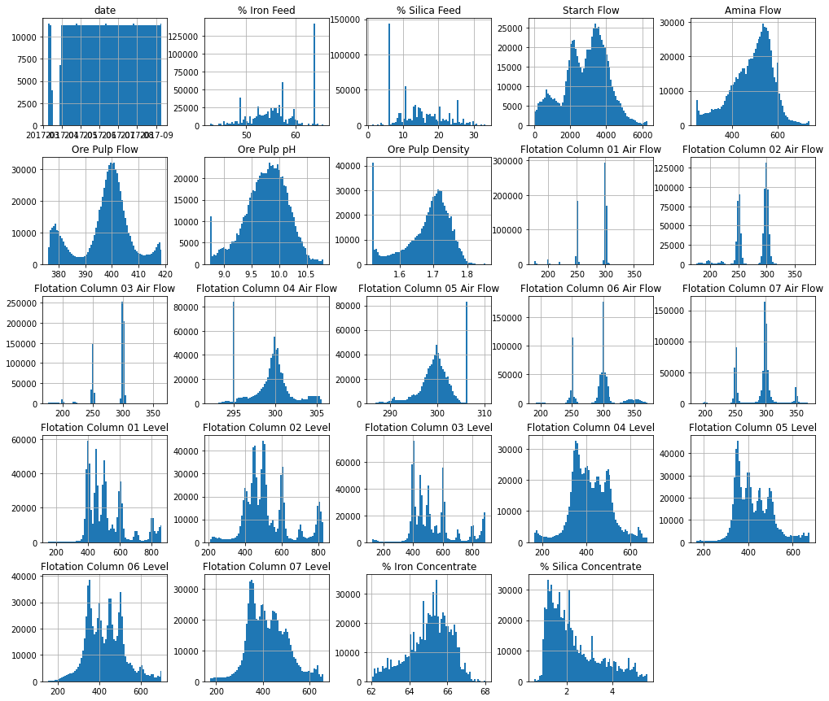
VISUALISATION OF GRAPHS
Pair plot usually gives pair wise relationships of the columns in the dataset From the above pair plot we infer
%Iron Feed, silica Feed, Starch Flow, Amina Flow, Ore pulp Flow, Ore pulp Flow, Ore pulp Density, Flotation Column 01 Air Flow, Flotation Column 02 Air Flow, Flotation Column 03 Air Flow, Flotation Column 04 Air Flow, Flotation Column 05 Air Flow, Flotation Column 06 Air Flow, Flotation Column 07 Air Flow, Flotation Column 01 Air Flow, Flotation Column 02 Level, Flotation Column 03 Level, Flotation Column 04 Level, Flotation Column 05 Level, Flotation Column 06 Level, Flotation Column 07 Level, Iron Concentrate, Silica Concentrate.

Slide 12
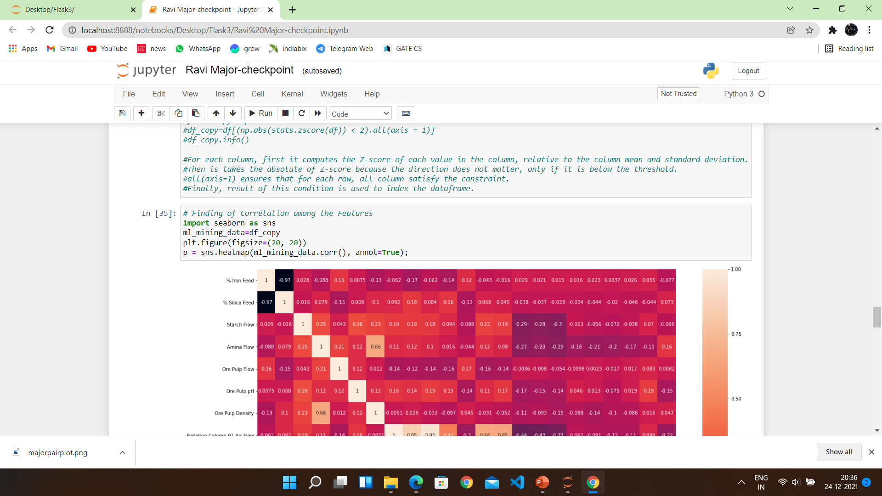
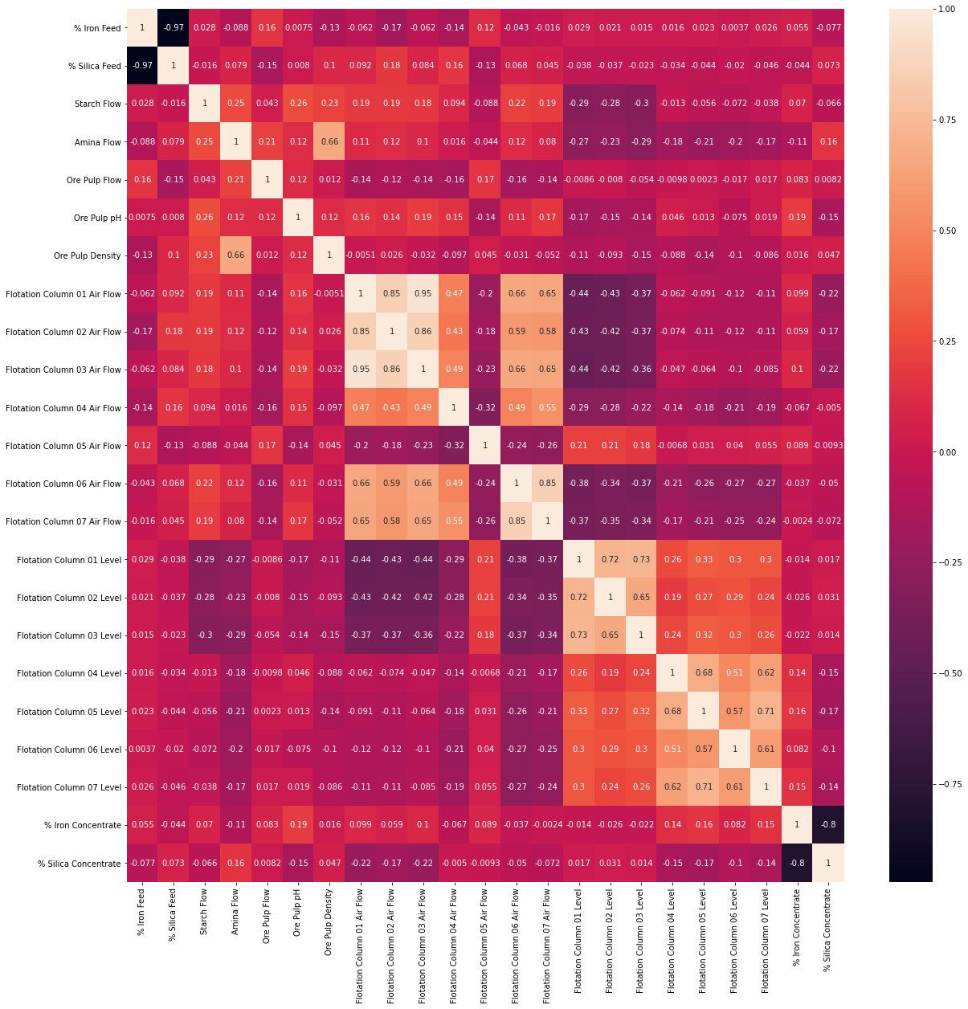

Slide 13
SOFTWARE REQUIREMENTS
Anaconda navigator
Jupyter notebook
Machine learning tools: pandas,
NumPy,
Matplotlib,
Seaborn

Slide 14
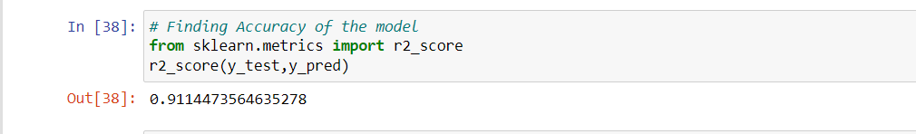
CONCLUSION
In this project we have presented the Prediction of Estimate The Presence Of Impurities In Iron.
We have done the Prediction using Machine Learning Techniques.
For the better results we used Decision Tree algorithm and proved with 91% accuracy.

